Slide 1
Managing Storage
Create Partitions
Manage Logical Volumes
Mount File Systems
Manage File Systems
Navigate the Linux Directory Structure
Troubleshoot Storage Issues

Slide 2
Storage Devices
A physical component that can record data and hold it persistently.
Many types supported by Linux:
HDDs
SSDs
USB thumb drives
External storage drives
Legacy storage drives

Slide 3
File Systems
A data structure used by an operating system to store, retrieve, organize, and manage files/directories on storage devices.
Maintains info such as:
File creation/modification date.
Size of files.
Type of files.
File permissions.
Provides a structure for data storage.
Doesn't interpret data; leaves that to programs.
Vary depending on purpose, type of info stored, how to store data, security, etc.

Slide 4
Types of File Systems
File System Type | Description
FAT | Older and compatible with most OSes. Limited capabilities.
ext2 | Used to be native file system of Linux. Still supported.
ext3 | Improvements to recovery speed and data integrity. Easily upgrade from ext2 to ext3.
ext4 | One current default file system on Linux (e.g., Ubuntu). Backward-compatible with ext2 and ext3. Improvements in volume size and journaling.
XFS | The other default file system on Linux (e.g., CentOS/RHEL 7). High-performance journaling. Fast recovery with large file size support.

Slide 5
Inodes (Slide 1 of 2)
Objects that store metadata about files and directories on a file system.
Metadata: Time values, permissions/ownership, block storage locations, etc.
Each inode is given a unique number.
System/apps search inode table for appropriate inode number.
Inode table maps numbers to file/directory names.
Some file systems set a max number of inodes on creation.
Usually considers size of overall file system.
Total number of files/directories can't exceed max.
Some file system types use dynamic allocation of inodes.
Scales with capacity rather than setting a strict limit.

Slide 6
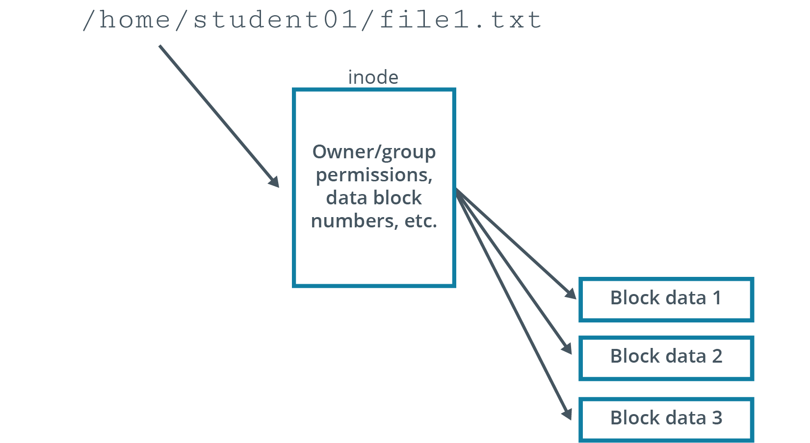
Inodes (Slide 2 of 2)

Slide 7
Journaling
A method by which a file system records changes that have not yet been made to the file system itself in an object called a journal.
File system can quickly recover after an interruption.
System references pending changes in journal to resume where it left off.
Process:
Journal describes all changes that must be made.
Background process makes each change when it is written to journal.
On system shutdown, pending changes are performed on reboot.
Incomplete entries in journal are discarded.

Slide 8
Virtual File System
A common software interface between the Linux kernel and various real file systems.
Linux supports many file system types.
Not always compatible with one another.
VFS translates file system details to kernel so it appears identical to systems.
You can mount multiple file system types in VFS.
They appear uniform to user and to apps.
Users/apps can work with file system without knowing its underlying structure.
Increases interoperability between system and software.

Slide 9
File System Labels
Assigned to file systems for easy identification.
Can be up to 16 characters long.
Use e2label for ext# file systems.
Use xfs_admin for XFS file systems.

Slide 10
Partitions
A section of a storage drive that logically acts as a separate drive.
Enable you to convert large drive into smaller chunks.
Better organization of information.
Must be formatted and assigned a file system first.
Identified using partition table.
Size of partition can vary, but cannot exceed total drive size.
Most OSes support partitioning.
Different types of data can be stored in separate locations.
Example: Separate system files from user-accessible files.

Slide 11
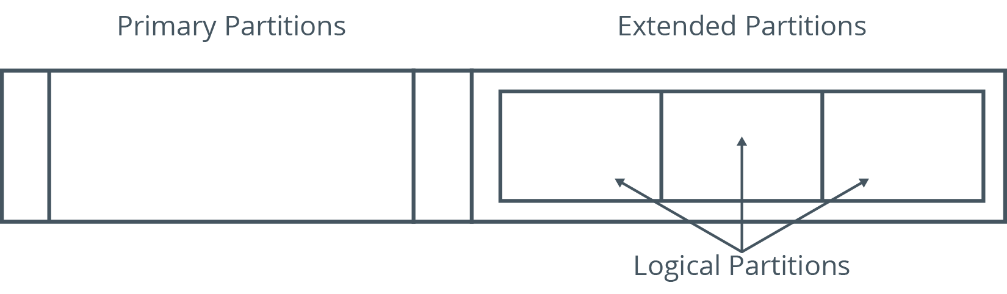
Types of Partitions (Slide 1 of 2)
11

Slide 12
Types of Partitions (Slide 2 of 2)
File System Type | Description
Primary | Can contain one file system or logical drive. Swap and boot are usually primary partitions.
Extended | Can contain several file systems (logical drives). Only one, but can be further subdivided. Has separate partition table.
Logical | Part of physical drive that acts as a separate drive. Created within extended partition. No limit, but 12 max is advisable.

Slide 13
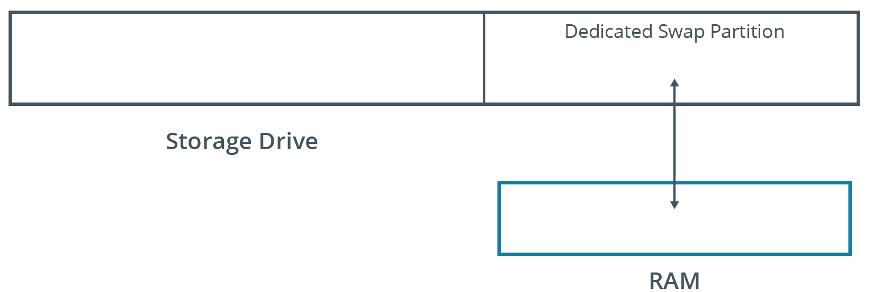
Swap Space
A partition on the storage device that is used when the system runs out of physical memory.
Linux pushes unused files from RAM to swap space.
Usually twice the physical RAM size.

Slide 14
The fdisk Utility (Slide 1 of 2)
Used to create, modify, and delete partitions.
You can create new partition table or modify existing one.
Understands DOS and Linux partition tables.
Enables you to specify partition size.

Slide 15
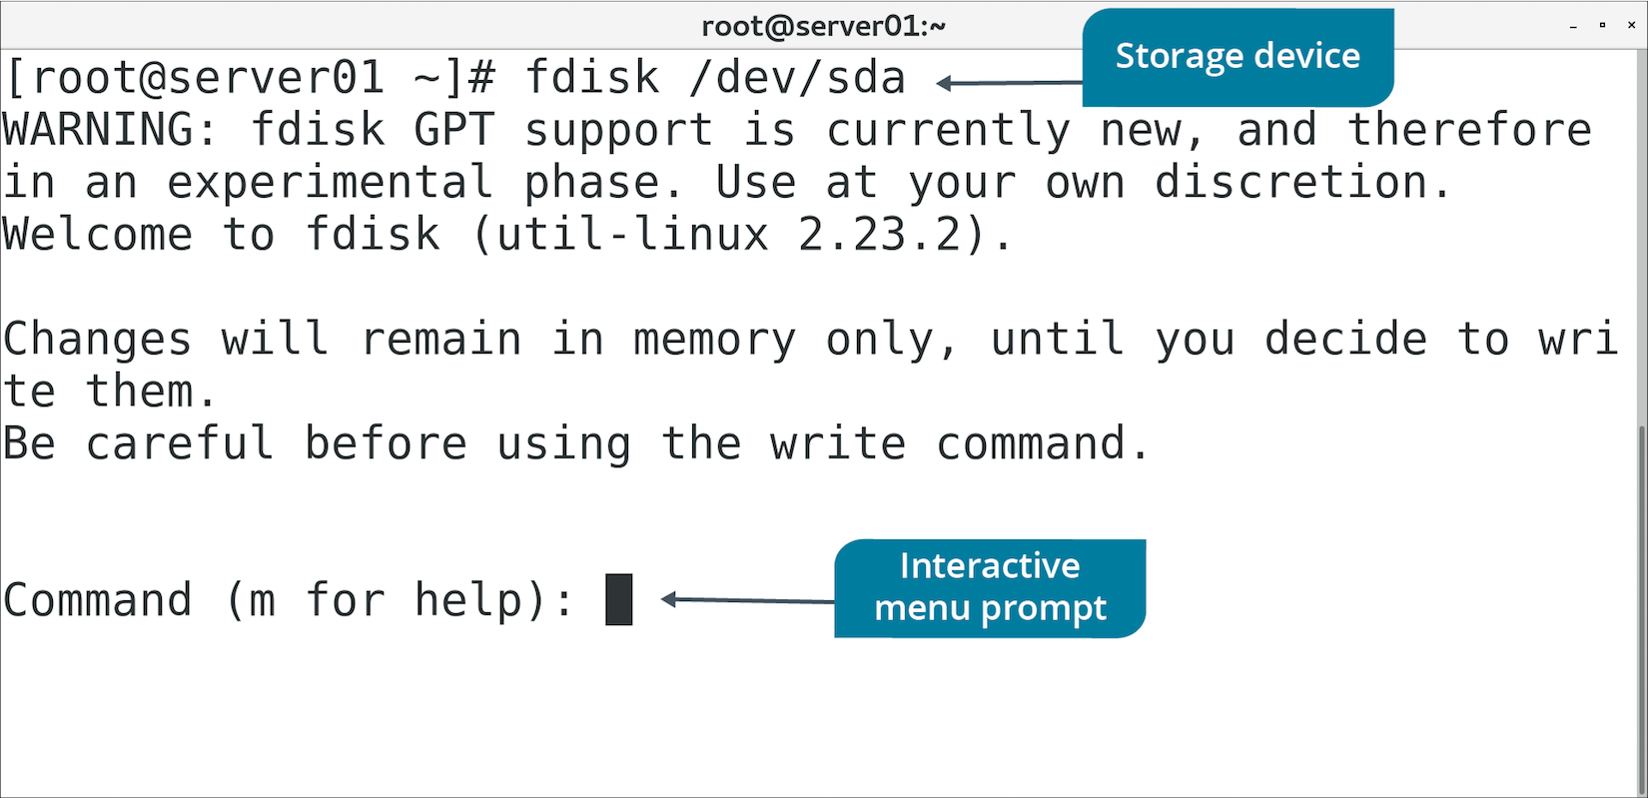
The fdisk Utility (Slide 2 of 2)

Slide 16
fdisk Menu Options (Slide 1 of 2)
Option | Used To
n | Create a new partition.
d | Remove a partition.
p | List existing partitions.
w | Write changes to drive and exit utility.
q | Cancel changes made and exit utility.

Slide 17
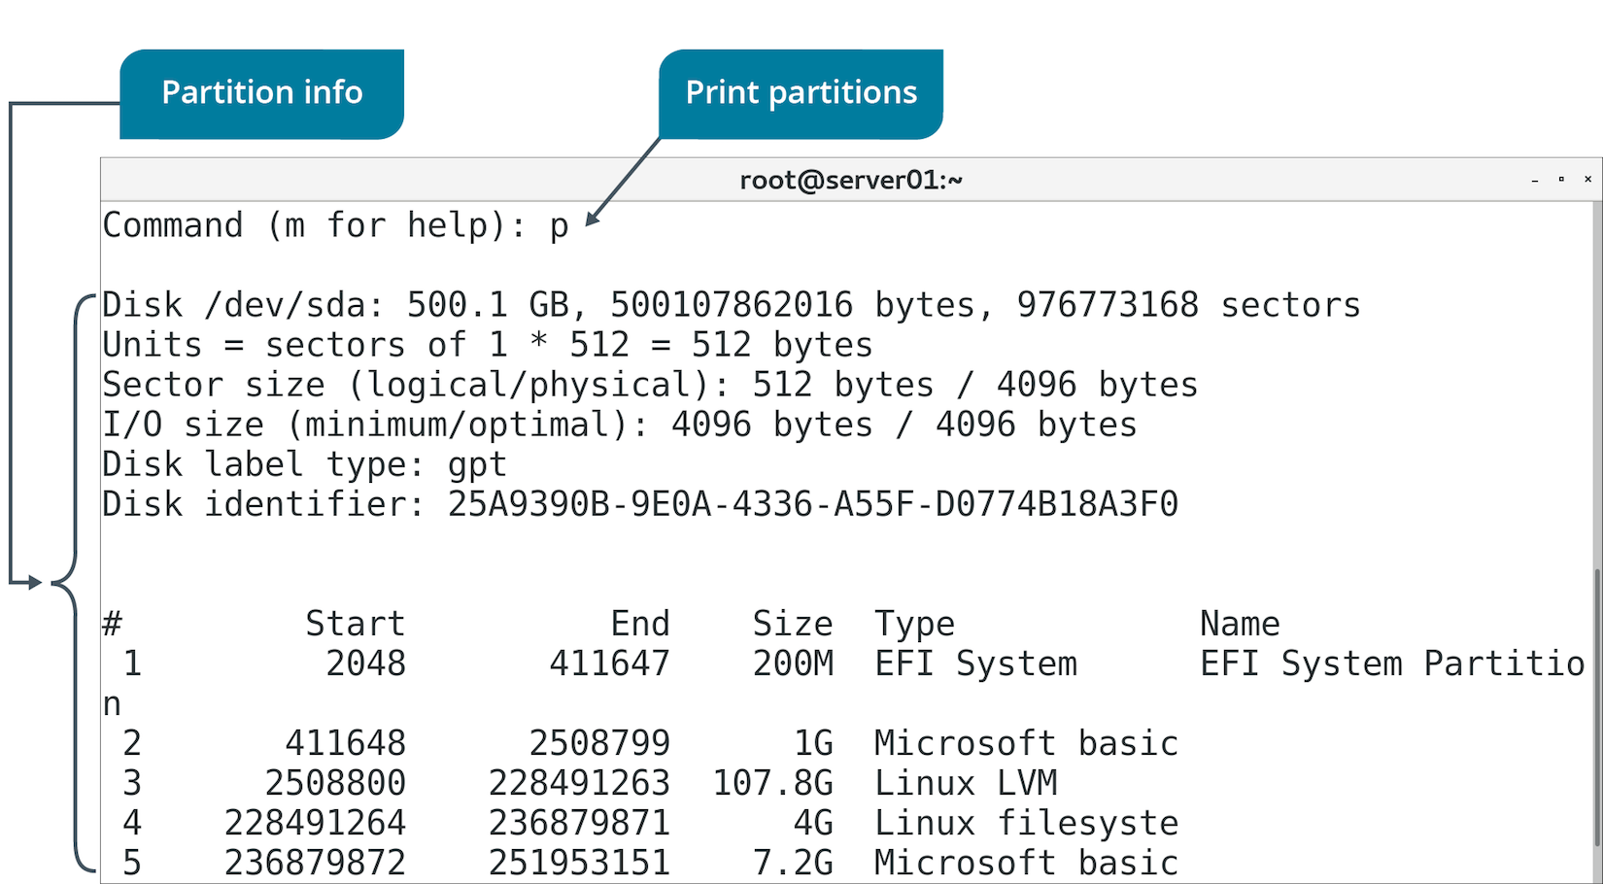
fdisk Menu Options (Slide 2 of 2)

Slide 18
GNU Parted (Slide 1 of 2)
A utility used to manage partitions.
Useful when creating partitions on new drives.
Can create, destroy, and resize partitions.
Run by issuing parted command.
Includes menu-driven interactive mode.

Slide 19
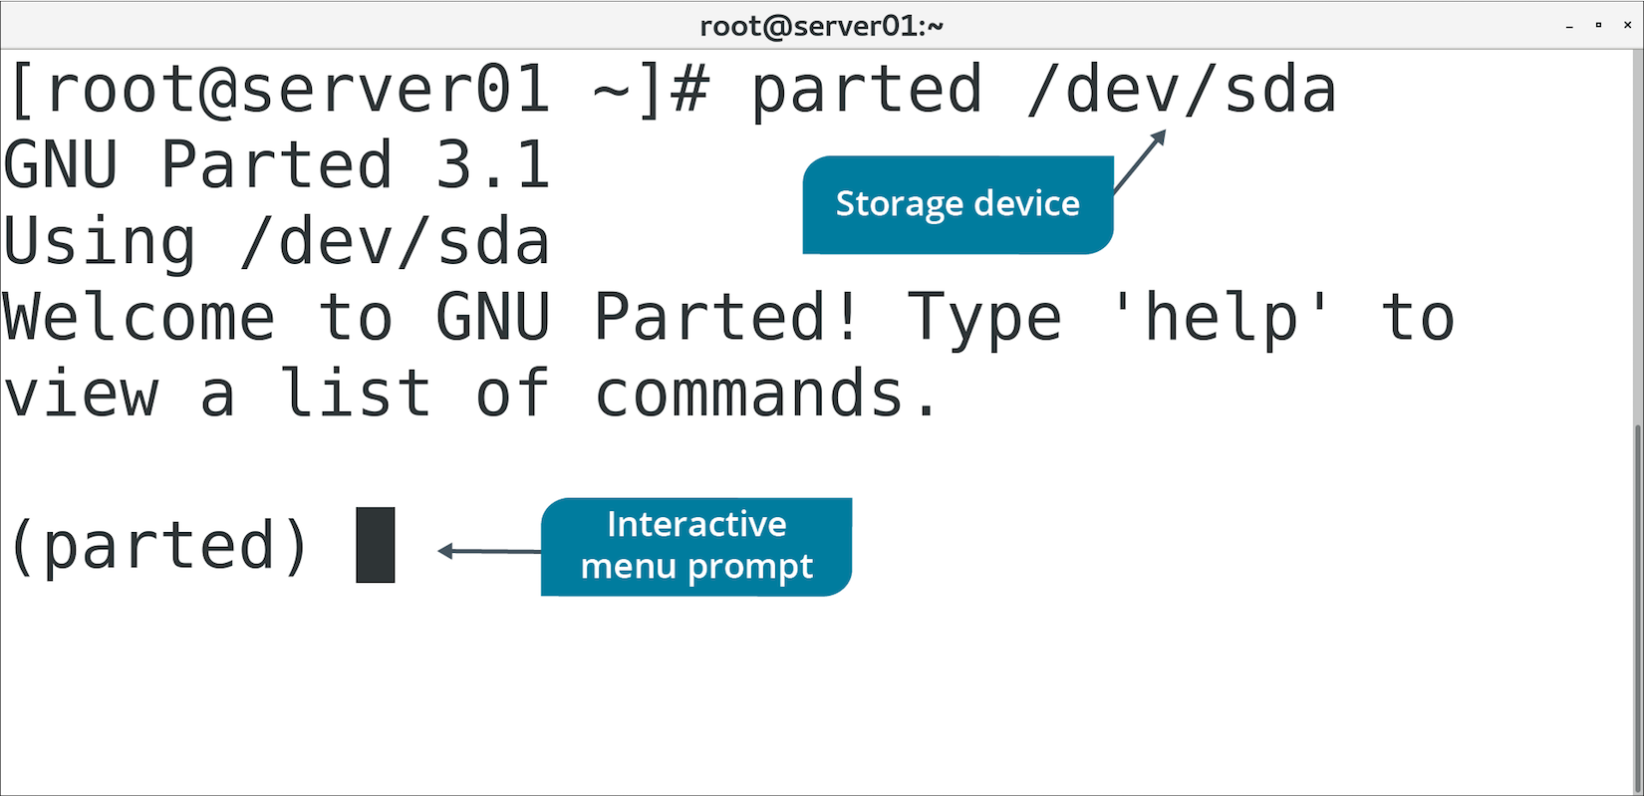
GNU Parted (Slide 2 of 2)

Slide 20
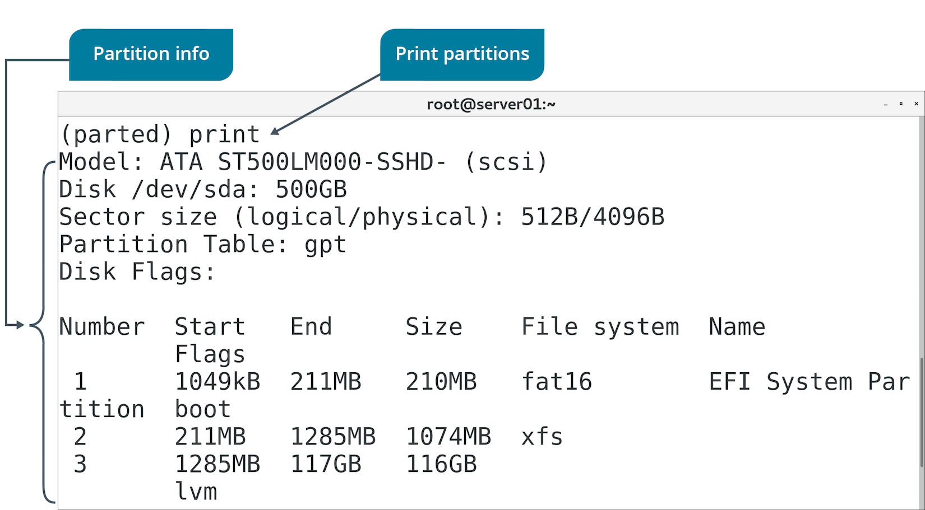
GNU Parted Menu Options (Slide 1 of 2)

Slide 21
GNU Parted Menu Options (Slide 2 of 2)
Option | Used To
select | Choose which device/partition to modify.
mkpart | Create partition with specified file system type.
print | List partition table.
resizepart | Modify end position of partition.
rm | Delete partition.
quit | Exit utility.

Slide 22
The partprobe Command (Slide 1 of 2)
Updates kernel with changes to partition table.
Checks table first, then updates kernel if it finds any changes.
Kernel needs to reference partition table for new partitions.
Can't add file system to new partition otherwise.
Might get partition table error during fdisk operation.
You can reboot to update the table.
Or, use partprobe to update it without a reboot.
Comes with GNU parted.

Slide 23
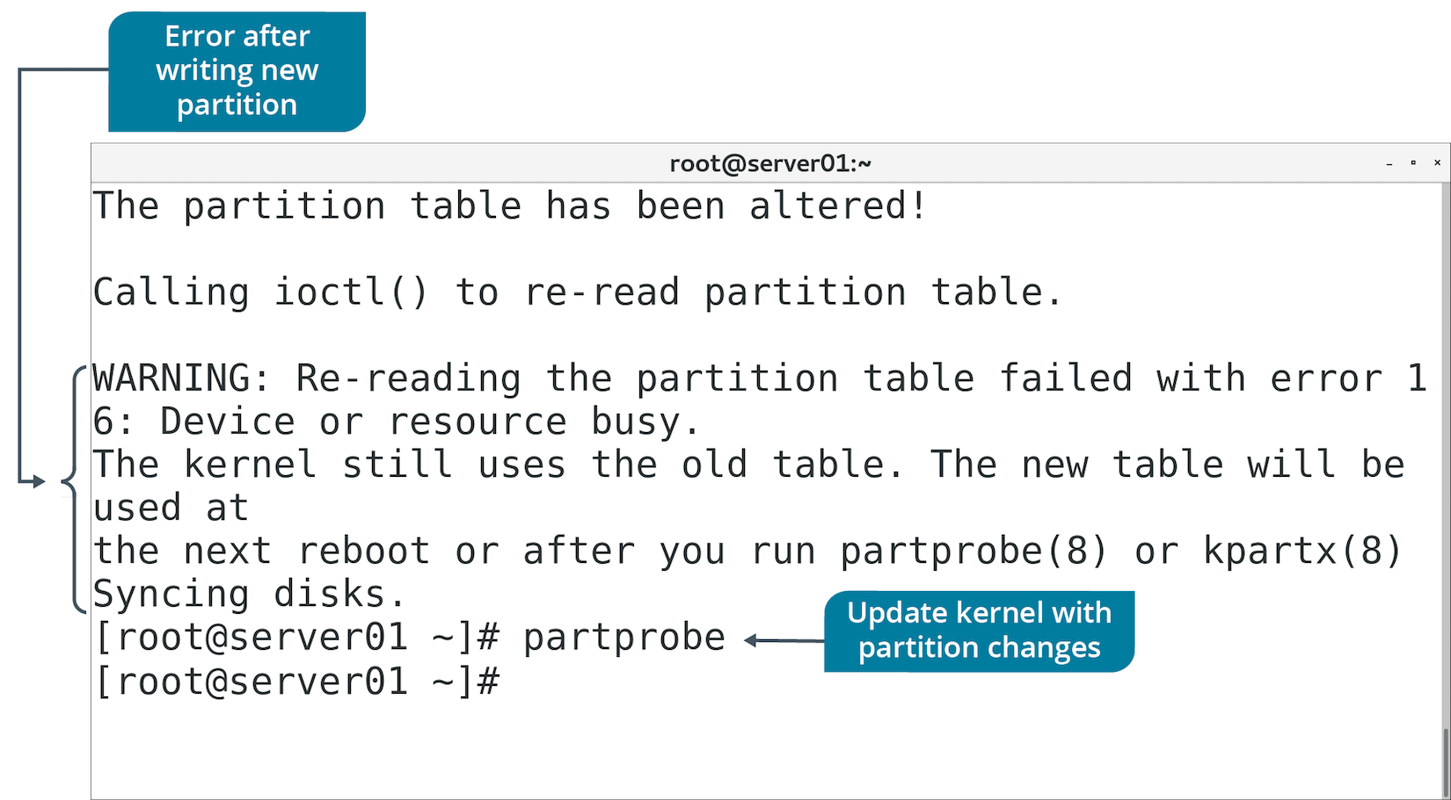
The partprobe Command (Slide 2 of 2)

Slide 24
The mkfs Command (Slide 1 of 2)
Used to build a Linux file system on a device/partition.
Option | Used To
-v | Produce verbose output.
-V | Produce verbose output including file system-specific commands.
-t {fstype} | Specify type of file system to build.
fs-options | Pass file system-specific options to builder.
-c | Check device for bad blocks before building.
-l {file name} | Read list of bad blocks from file.

Slide 25
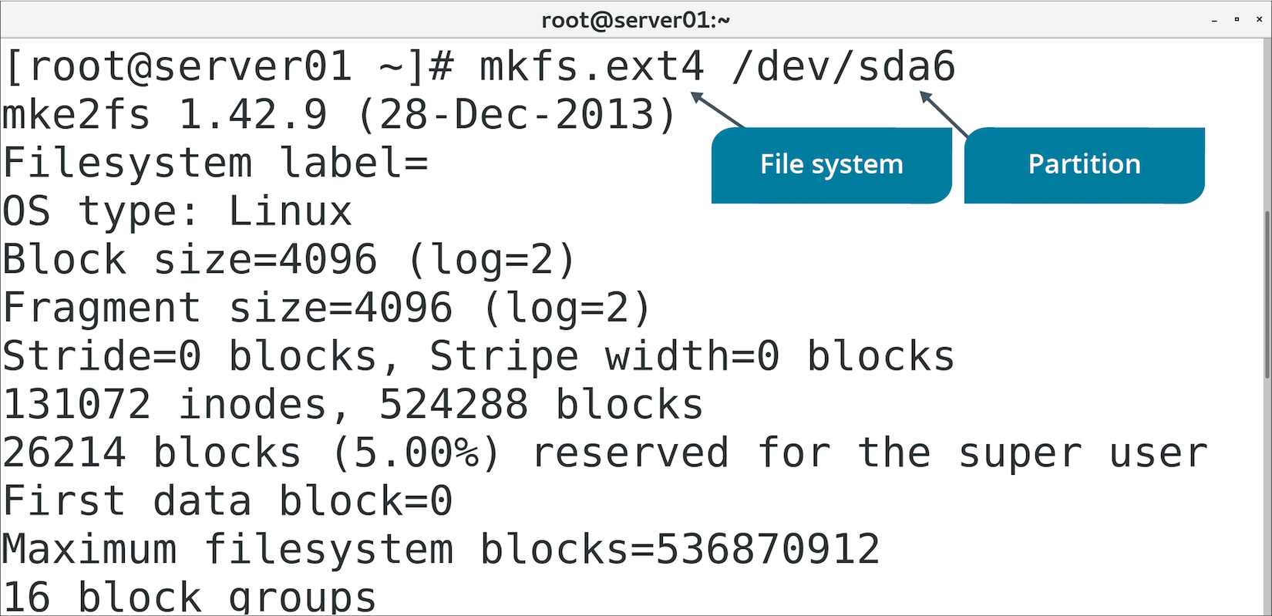
The mkfs Command (Slide 2 of 2)

Slide 26
The fstab File (Slide 1 of 2)
Configuration file that stores device, partition, and mount info.
Located in /etc directory.
Only root can edit.
Consists of one line for each file system.
Field | Description
Device/partition name | Name of device/file system to mount.
Default mount point | Where to mount file system.
File system type | Type of file system used by device/partition.
Mount options | Values activated when file system is mounted.
dump options | Indicates if dump should back up file system.
fsck options | Order in which fsck should check file system.

Slide 27
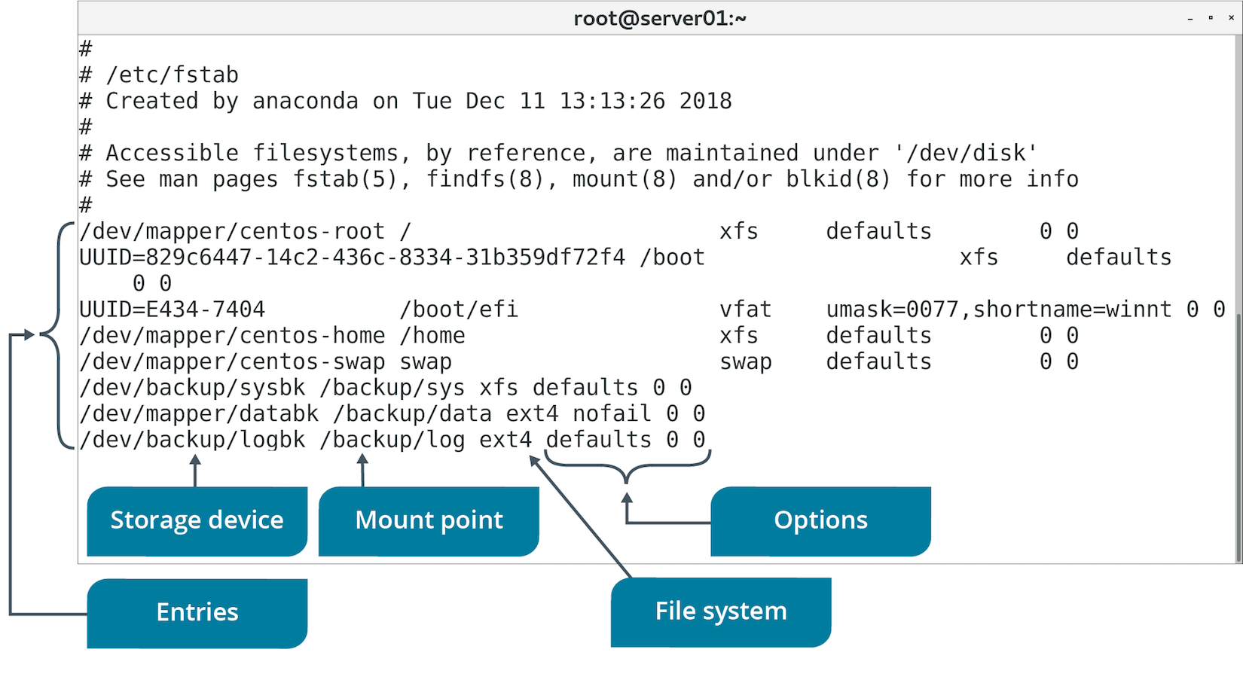
The fstab File (Slide 2 of 2)

Slide 28
The Storage Device Setup Process
Partition the storage device.
Format the partition with a file system.
Add the partition to the fstab file so it is configured on boot.

Slide 29
The /dev/ Directory
Contains files that represent and support attached devices.
Linux uses naming conventions for system to easily locate devices.
Naming convention usually consists of three parts.
/dev/sda1
sd refers to type of controller (in this case, SCSI/SATA).
a refers to first whole drive.
1 refers to first partition on drive.
You'll use this naming convention when managing drives/partitions.

Slide 30
Discussing Partitions

Slide 31
Activity: Creating Partitions
Develetech is concerned about losing data.
You'll create partitions for backups:
System files (XFS).
Business files/user data (ext4).
You'll just create them for now.

Slide 32
Device Mapping
The process of abstracting physical storage devices into virtual storage devices.
Device mapper creates virtual device.
Passes data from virtual device to one or more physical devices.
Several apps leverage device mapper.
Volume encryption/integrity checking apps.
Act upon data transmitted between physical and virtual devices.

Slide 33
Logical Volume Manager (Slide 1 of 2)
Software that maps physical devices and partitions to logical volumes.
Leverages device mapper.
Maps physical devices to containers called volume groups.
Volume groups contain one or more logical volumes.
Logical volumes are the endpoints that system/user/apps work with.
Many distros support LVM.

Slide 34
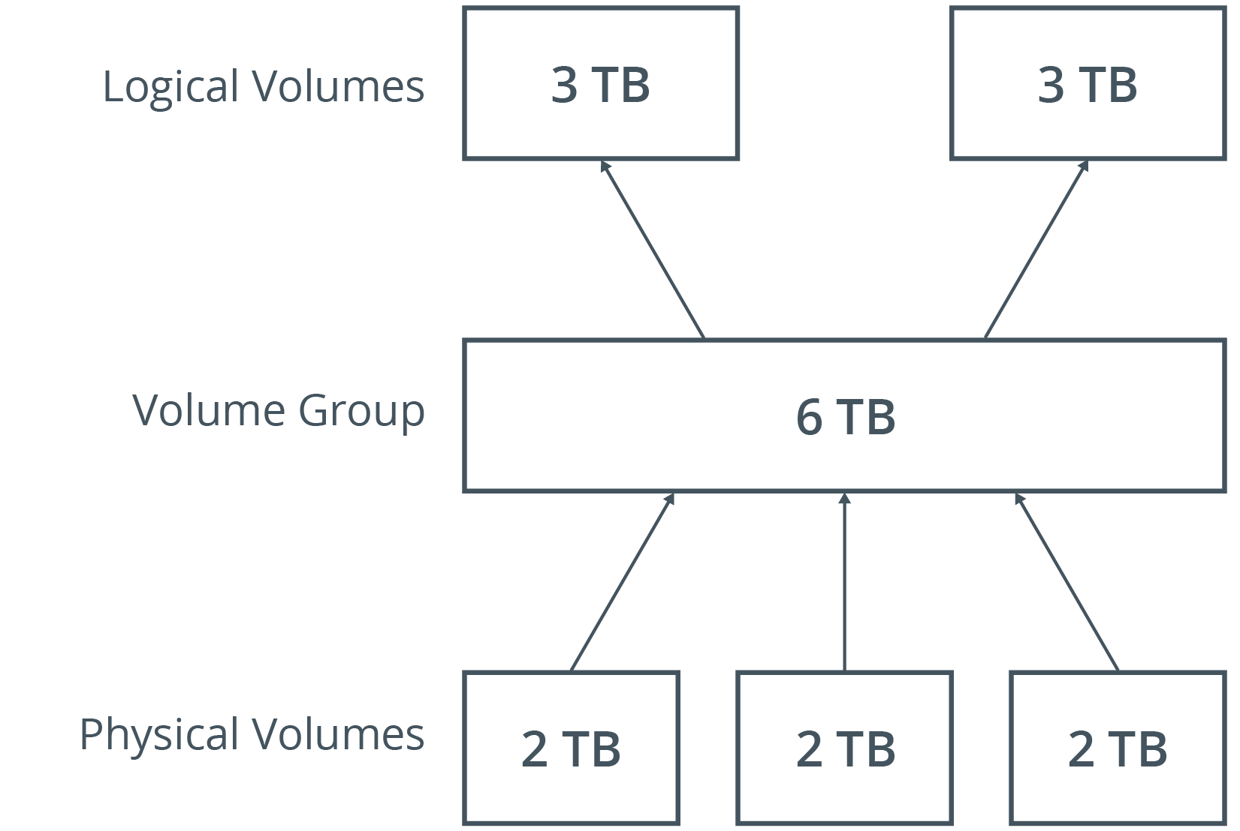
Logical Volume Manager (Slide 2 of 2)

Slide 35
LVM Advantages
Compared to physical partition management:
You can dynamically manage volumes without having to reboot.
Day-to-day volume management is easier.
You can map multiple logical volumes across multiple physical devices.
Logical volumes can exceed the size of any one physical device.
You can create snapshots of logical volumes.
Downside: Initial setup can be complex.

Slide 36
The /dev/mapper/ Directory
Contains all logical volumes on system managed by LVM.
Format:
/dev/mapper/<volume group name>-<logical volume name>
May include links to actual volume location.

Slide 37
LVM Tools
Three categories:
Physical volume (PV) tools
Volume group (VG) tools
Logical volume (LV) tools

Slide 38
PV Tools
Tool | Used To
pvscan | Scan for all physical devices used as PVs.
pvcreate | Initialize drive/partition as a PV.
pvchange | List attributes of PVs.
pvs | Display info about PVs.
pvck | Check metadata of PVs.
pvremove | Remove PVs.

Slide 39
VG Tools (Slide 1 of 2)
Tool | Used To
vgscan | Scan all physical devices for VGs.
vgcreate | Create VGs.
vgdisplay | List attributes of VGs.
vgchange | Change attributes of VGs.
vgs | Display info about VGs.
vgck | Check metadata of VGs.

Slide 40
VG Tools (Slide 2 of 2)
Tool | Used To
vgrename | Rename VGs.
vgreduce | Remove physical volumes from VGs.
vgextend | Add physical volumes to VGs.
vgmerge | Merge two VGs.
vgsplit | Split VG into two.
vgremove | Remove VGs.

Slide 41
LV Tools (Slide 1 of 2)
Tool | Used To
lvscan | Scan all physical devices for LVs.
lvcreate | Create LVs in a VG.
lvdisplay | List attributes of LVs.
lvchange | Change attributes of LVs.
lvs | Display info about LVs.

Slide 42
LV Tools (Slide 2 of 2)
Tool | Used To
lvrename | Rename LVs.
lvreduce | Reduce size of LVs.
lvextend | Extend size of LVs.
lvresize | Resize LVs.
lvremove | Remove LVs.

Slide 43
Discussing Logical Volumes

Slide 44
Activity: Managing Logical Volumes
There are more efficient ways of managing storage.
You'll consolidate space on both partitions.
Create a physical volume using LVM.
Create a volume group and logical volumes.
You also need a third backup space for log files.
Space requirements might fluctuate.
Logical volume will work better than a physical partition.

Slide 45
Mount Points
An access point to information stored on a local or remote storage device.
File system is loaded (mounted) to make it accessible.
Typically mounted on empty directory.
If directory has content, content is invisible until file system is unmounted.

Slide 46
The mount Command
Loads file system into directory.
Makes file system usable.
You must specify device to mount and mount point.

Slide 47
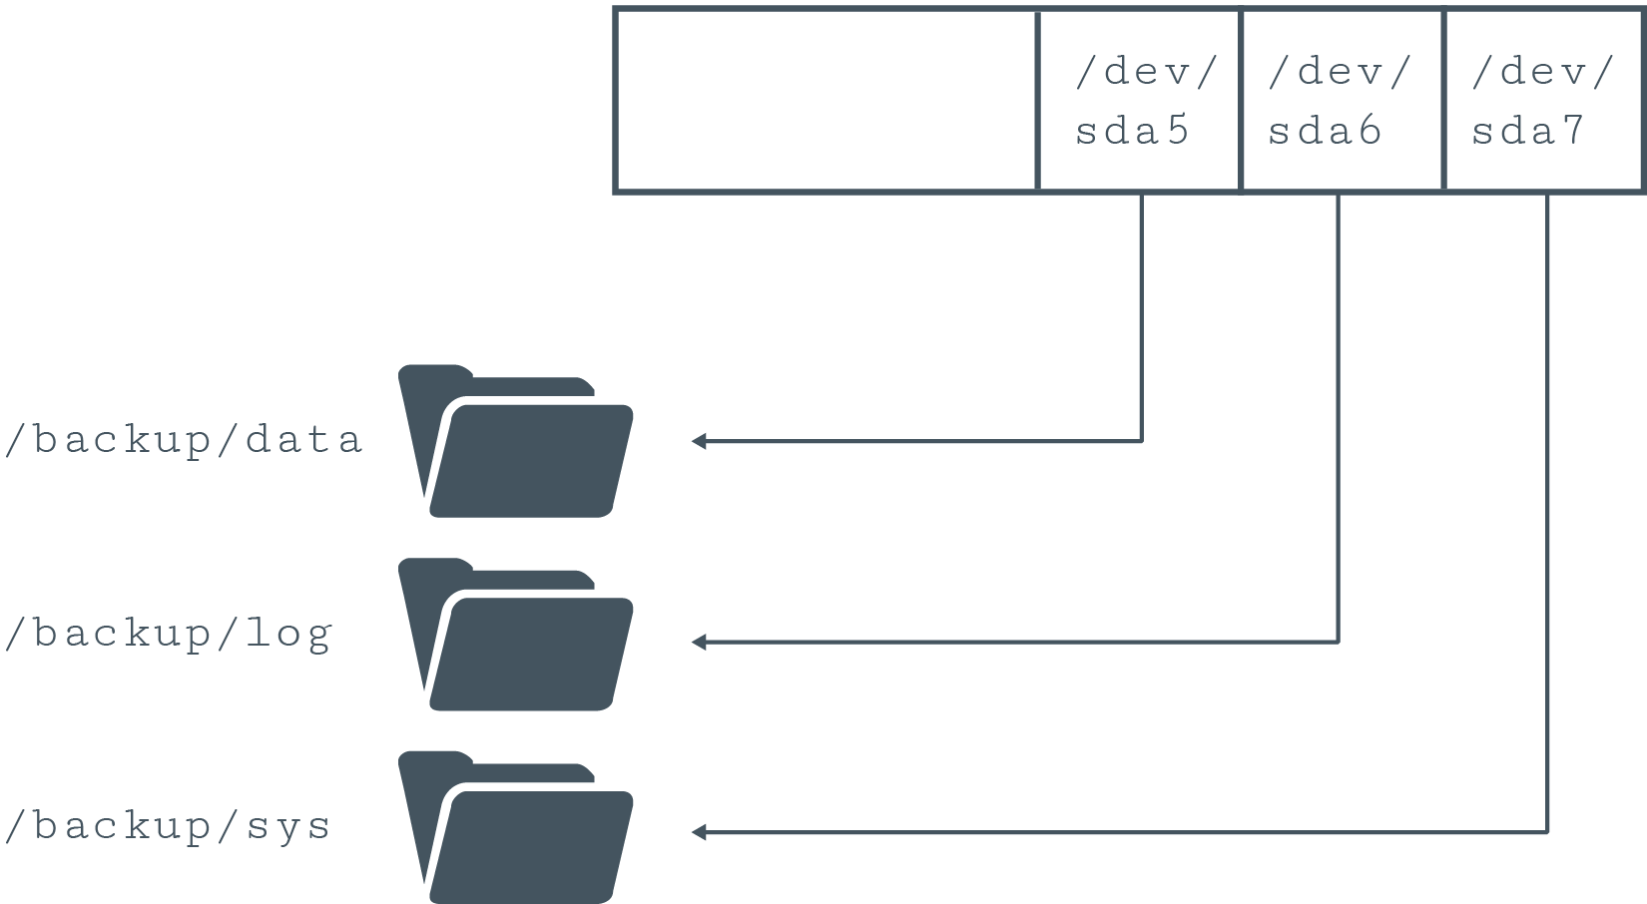
Mounting Partitions to Directories

Slide 48
mount Options (Slide 1 of 2)
Option | Used To
auto | Specify device must be mounted automatically.
noauto | Specify device shouldn't be mounted automatically.
nouser | Specify only root user can mount device.
user | Specify all users can mount device.
exec | Allow execution of binaries in a file system.

Slide 49
mount Options (Slide 2 of 2)
Option | Used To
noexec | Prevent execution of binaries in a file system.
ro | Mount file system as read-only.
rw | Mount file system with read and write permissions.
sync | Specify I/O operations should be done synchronously.
async | Specify I/O operations should be done asynchronously.

Slide 50
The umount Command
Disassociates file system from mount point.
File system must not be in use.
Example: App has a file open.

Slide 51
Discussing Mounting File Systems

Slide 52
Activity: Mounting File Systems
Your volumes aren't usable yet; need to mount them first.
Mount points:
/backup/sys/
/backup/data/
/backup/log/
Volumes should mount automatically on boot.

Slide 53
The /proc/mounts File
Lists status of all currently mounted file systems.
Format similar to fstab
Not a real file; part of virtual file system.
Represents status of file systems as reported by kernel.
Typically read using cat or similar command.
Lists all file systems, not just storage drives/partitions.

Slide 54
The /proc/partitions File (Slide 1 of 2)
Contains info about each partition.
Not a real file; part of VFS.
Column format:
major
minor
#blocks
name

Slide 55
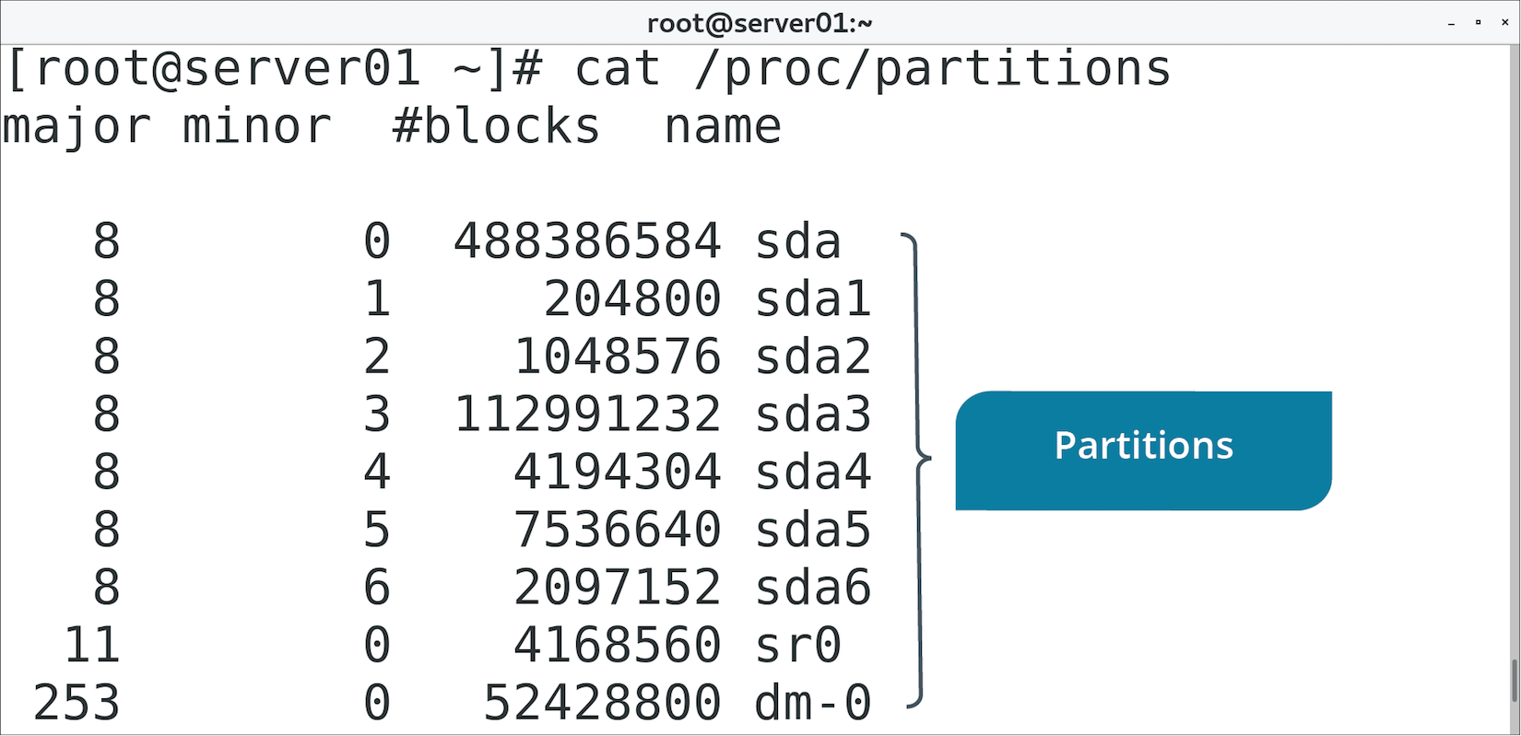
The /proc/partitions File (Slide 2 of 2)

Slide 56
The lsblk Command (Slide 1 of 2)
Displays info about all block storage devices.
Output is in tree-like format.
Physical devices at top, partitions/logical volumes branch off.
Displays names, major/minor numbers, type, mount point.

Slide 57
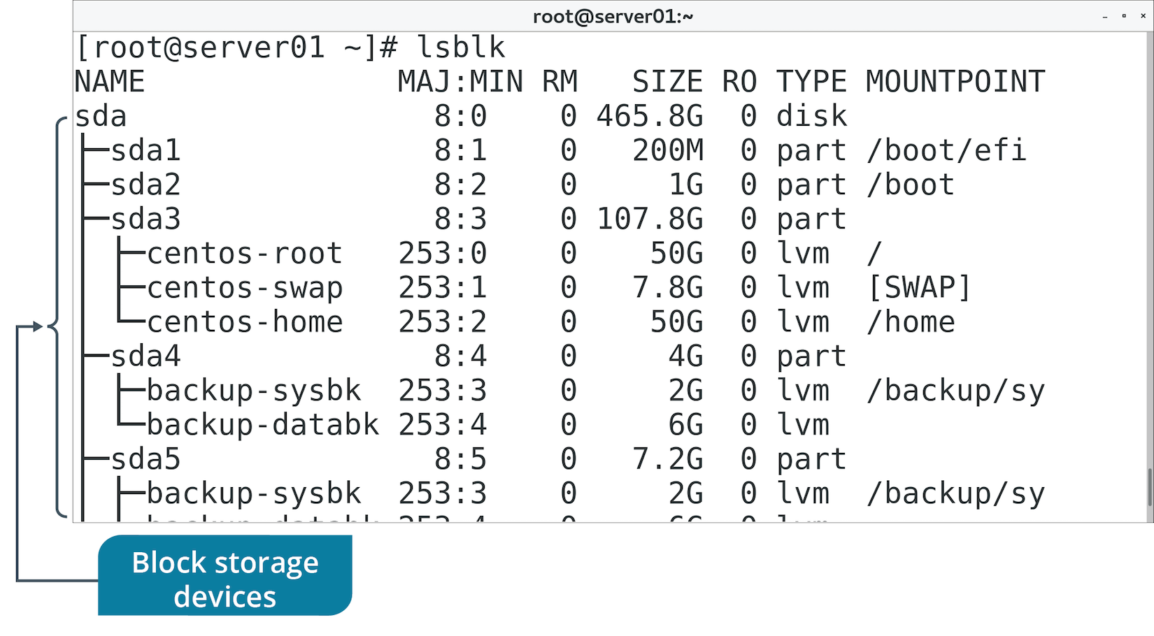
The lsblk Command (Slide 2 of 2)

Slide 58
The blkid Command
Similar to lsblk command.
Prints block device info in flat format.
Includes additional info like UUIDs and file system types.
Using lsblk -f is preferable.

Slide 59
ext Tools
Some tools are designed to work with specific file system types.
Several tools can work with ext2/3/4:
e2fsck
resize2fs
tune2fs
dumpe2fs

Slide 60
The fsck Command (Slide 1 of 2)
Checks integrity of file system.
Integrity refers to correctness and validity of file system.
Most systems run fsck at boot.
Errors usually caused by power/hardware failures or improper shutdown.
Unmount file system before using fsck to prevent damage.

Slide 61
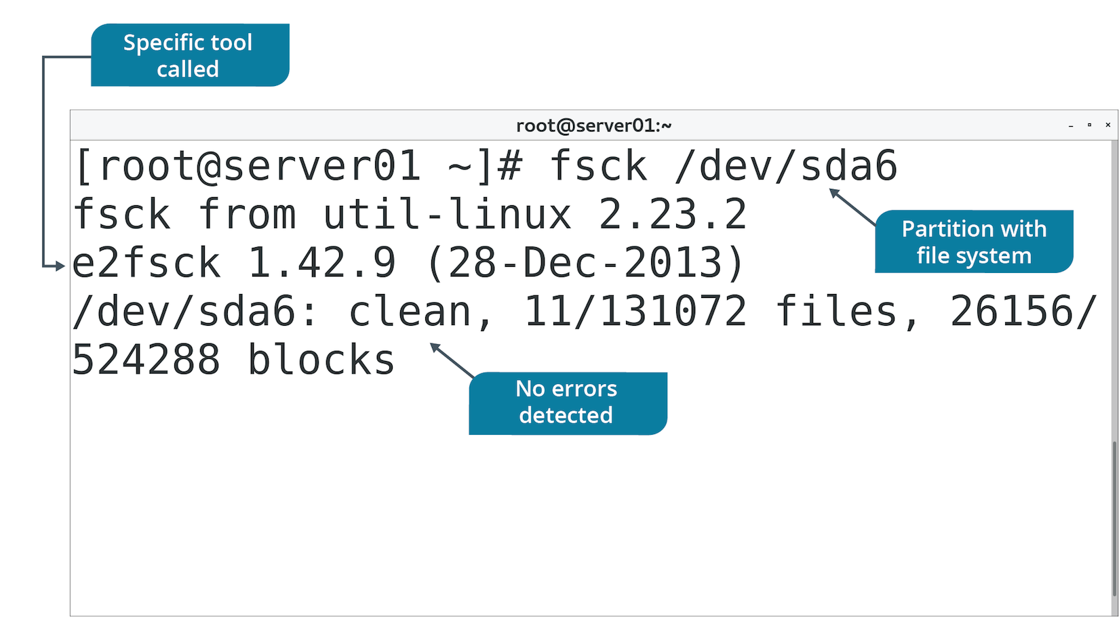
The fsck Command (Slide 2 of 2)

Slide 62
The resize2fs Command
Enlarges or shrinks ext2/3/4 file system.
Must unmount file system to shrink it.
You can specify desired size of file system.
If you don't, it gets resized to size of partition.
Does not resize partitions, only file systems.
Use fdisk or LVM tools to expand size of partition/volume first.

Slide 63
The tune2fs Command
Configures tunable parameters on ext2/3/4 file systems.
Tunable parameters enable you to:
Remove reserved blocks.
Alter reserved block count.
Specify number of mounts between checks.
Specify time interval between checks.
And more.
You can also use tune2fs to add a journal to ext2/3 file systems.

Slide 64
The dumpe2fs Command (Slide 1 of 2)
Used to dump ext2/3/4 file system info.
Prints superblock and block group info for device.
Useful when troubleshooting faulty file system.

Slide 65
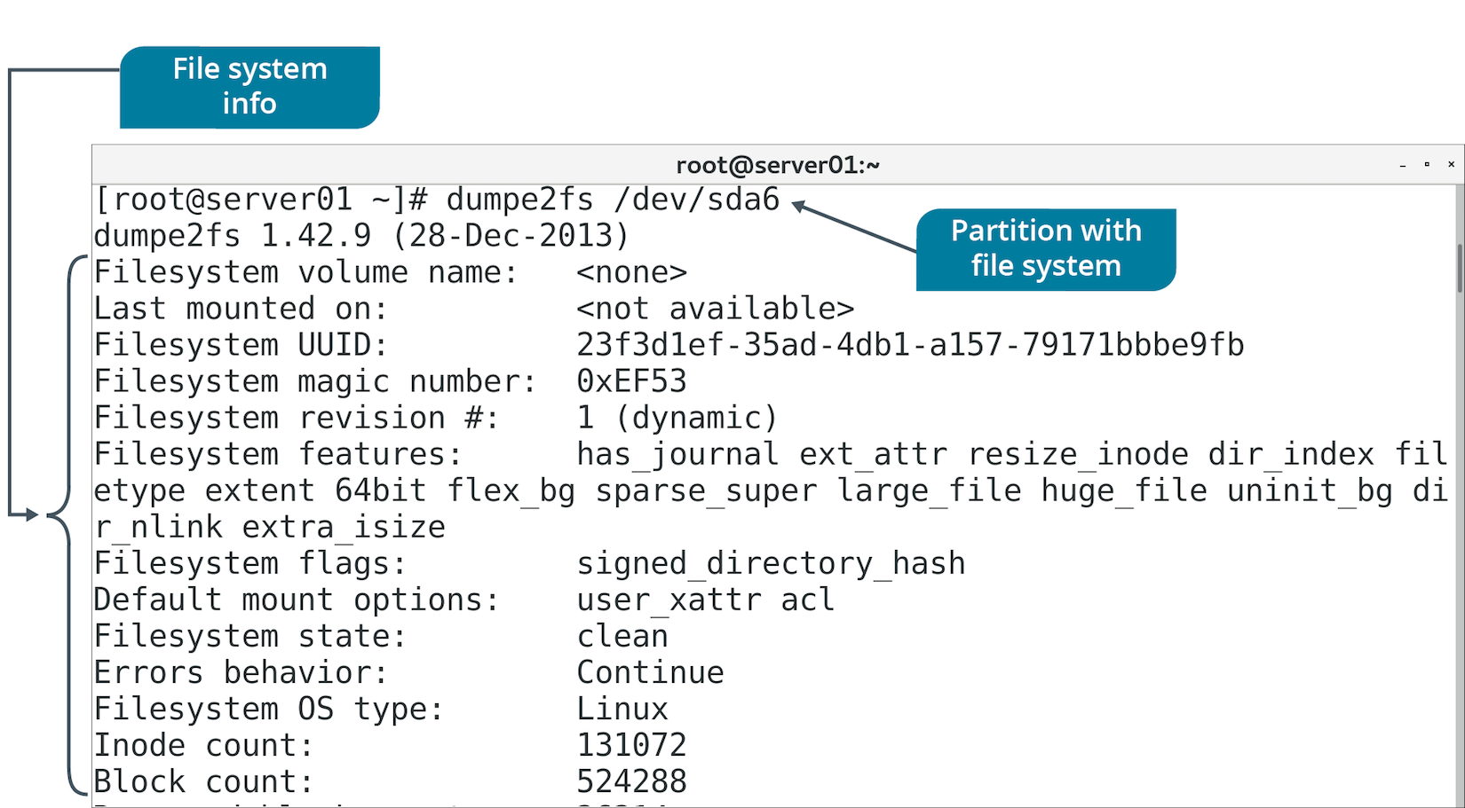
The dumpe2fs Command (Slide 2 of 2)

Slide 66
XFS Tools
Tool | Used To
xfs_info | Display details about file system.
xfs_admin | Change parameters of file system.
xfs_metadump | Copy superblock metadata of file system to a file.
xfs_growfs | Expand file system to fill drive size.
xfs_copy | Copy contents of file system to another location.
xfs_repair | Repair and recover corrupt file system.
xfs_db | Debug file system.

Slide 67
Discussing Managing File Systems

Slide 68
Activity: Managing File Systems
You want to perform scheduled maintenance on volumes.
Check them for errors.
Size of volumes needs to increase.
Must change file system size as well.

Slide 69
Types of Files
File Type | Description
Directories (d) | Container for other files.
Special files | Includes block special files (b) and character special files (c).
Links (l) | Makes files accessible to other parts of file system tree.
Domain sockets (s) | Provides inter-process networking.
Named pipes (p) | Enables process communication without network sockets.

Slide 70
File Naming Conventions
Ensure file names are unique and easy to recognize.
On ext4, file name:
Up to 255 bytes.
No NULL character or forward slash.
The names . and .. are reserved.
Different file systems enforce different rules.
Spaces are possible in file names, but not preferred.
Consider demarcating words by hyphens or underscores:
audit-file.txt
audit_file.txt

Slide 71
The Filesystem Hierarchy Standard
A set of guidelines for the names of files and directories and their locations on Linux systems.
A collaborative document.
Most distros are FHS-compliant.
Supports compatibility between systems.
Creates naming convention to benefit users and software.
Helps them consistently find and store files.

Slide 72
Standard Directories (Slide 1 of 2)
Directory | Description
/bin | Essential command-line utilities/binaries.
/boot | Files necessary to boot Linux.
/dev | Hardware and software device drivers.
/etc | Basic configuration files.
/home | Users' home directories.
/lib | Shared program libraries.
/media | Mount points for removable media.
/mnt | Mount point for temporarily mounting file systems.

Slide 73
Standard Directories (Slide 2 of 2)
Directory | Description
/opt | Optional files or large software packages.
/proc | VFS that reports kernel information.
/root | Root user's home directory.
/sbin | Binaries used in booting and by the root user.
/sys | VFS storing information about devices.
/tmp | Temporary files.
/usr | Read-only directory of programs/files accessible to all users.
/var | Variable files (expected to constantly change).

Slide 74
The Home Directory (Slide 1 of 2)
A container for the user's personal files or files specific to that user.
Where you are placed when you log in.
User is placed in a subdirectory in /home that corresponds to their user name.
User can create subdirectories/files here.
Home directory of root user is /root
Not to be confused with root directory (/).
Most shells indicate home directory with a tilde (~).

Slide 75
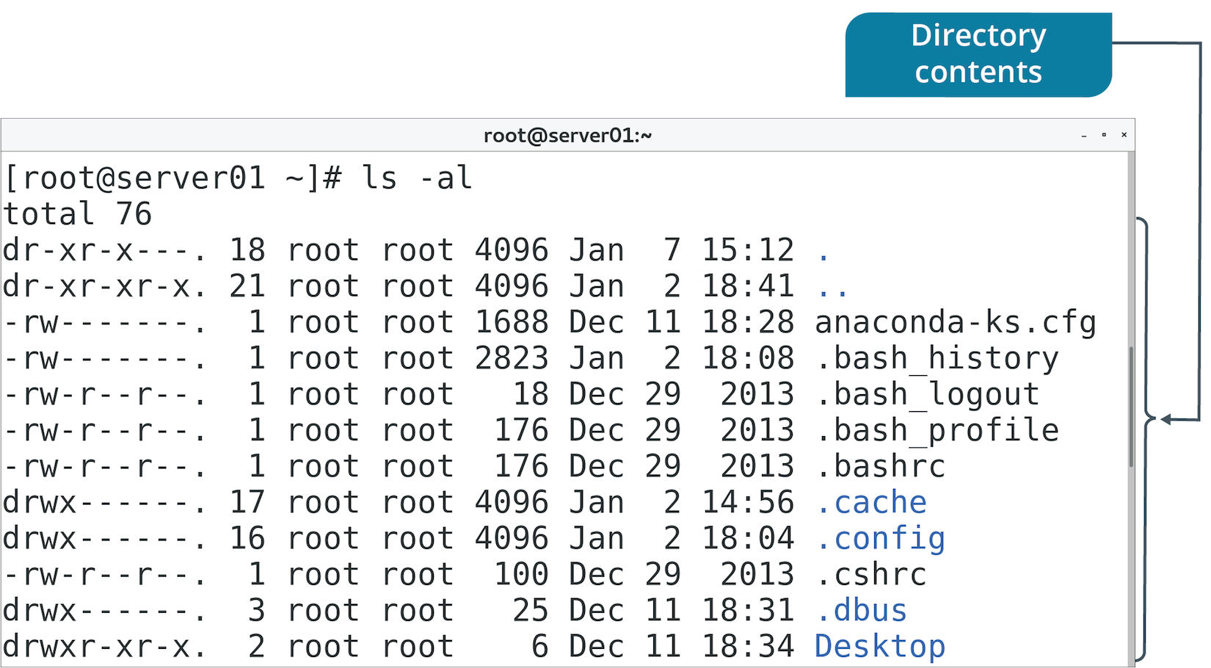
The Home Directory (Slide 2 of 2)

Slide 76
The Current Working Directory
The location that you are accessing at any point in time.
Example: When you log in, your CWD is /home/<user name>
Represented in shorthand by single period (.)
Use pwd to identify.

Slide 77
The Parent Directory
The directory that is one level above your current working directory.
All directories except root (/) have a parent.
Use double periods (..) to switch to parent.

Slide 78
Paths
A specification of an object's location in a file system.
Begins with root directory and ends with file/directory you want to access.
You've worked with paths to access various files/directories.
Refer to a file by providing path to that file.
Home directory is jsmith
Contains subdirectory work
Contains file mywork
Path is: /home/jsmith/work/mywork
Forward slash (/) separates items.
First instance represents root directory.

Slide 79
Absolute vs. Relative Paths
Absolute path is a specific location.
Irrespective of CWD or combined paths.
References root directory.
Starts with forward slash.
Relative path is based on CWD.
Don't begin with forward slash.
Full absolute path not necessary.
Can contain CWD (.) and parent directory (..) indicators.

Slide 80
File System Navigation Commands
Command | Used To
cd | Traverse directory structure to change CWD.
ls | List files/directories in CWD or path specified.
pwd | Print CWD to console.

Slide 81
Discussing the Linux Directory Structure

Slide 82
Activity: Navigating the Linux Directory Structure
You need to become more familiar with the Linux file structure.
You'll be able to find what you're looking for more easily.
You'll walk through several main directories.

Slide 83
Common Storage Issues
Missing devices
Missing volumes
Missing mount points
Degraded storage
Performance issues
Resource exhaustion
Storage integrity/bad blocks

Slide 84
Storage Space Tracking (Slide 1 of 2)
The df command displays device's:
Free space
File system
Total size
Percentage of space used
Mount point
The du command displays file or directory sizes.
Can track space hogs.
Go-to commands for troubleshooting space issues.

Slide 85
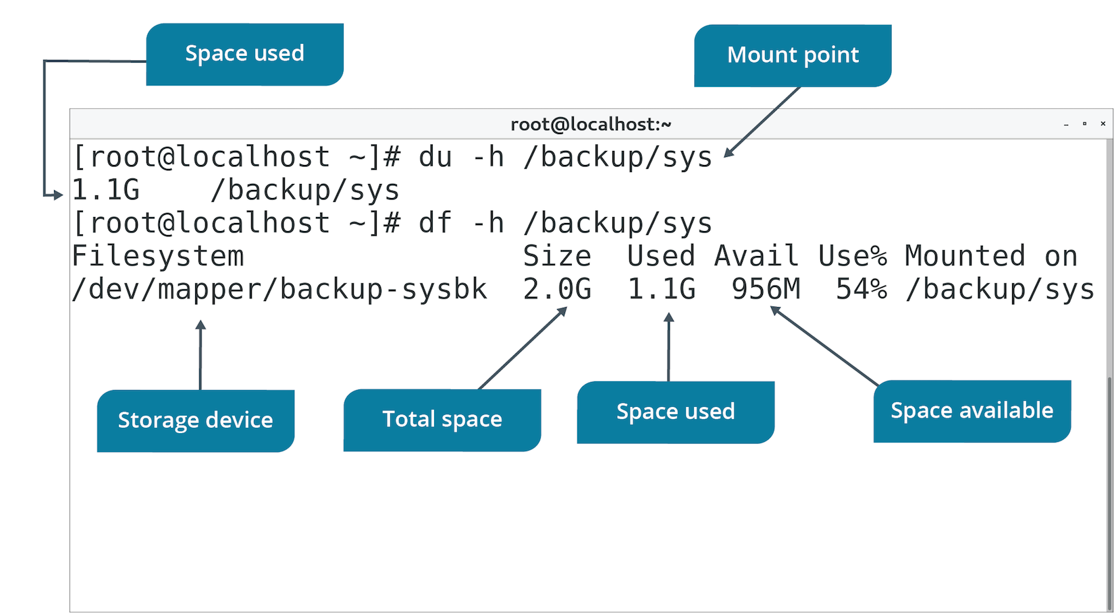
Storage Space Tracking (Slide 2 of 2)

Slide 86
I/O Scheduling
The process by which the OS determines the order of I/O operations as they pertain to block storage devices.
Block storage operations are slow compared to CPU/memory operations.
Especially in disk-based technology.
Kernel doesn't just begin reading/writing in order requests are submitted.
Instead, it prioritizes some requests over others.
Minimizes performance issues.
You can configure scheduler with different behavior types.
Some are more suited to certain workloads.

Slide 87
Scheduler Types
Type | Description
deadline | Uses standard pending request queue, read FIFO queue, and write FIFO queue. FIFO queues sorted by submission time and have expiration. Request is sorted into standard queue and placed at end of FIFO queue. Stops servicing standard queue when request in FIFO queue exceeds expiration. Ensures scheduler doesn't starve a request. Ideal in multi-threaded workloads.
cfq | Each process has its own queue and queue has a time slice. Scheduler uses round-robin system for accessing each queue. Waits until time slice or requests are exhausted. Waits for a new request, and if there isn't one, it moves on to next queue. Minimizes starvation. Services processes fairly with good overall performance. Default scheduler of Linux kernel.
noop | Simple; doesn't sort, just merges requests. Ideal when device does its own sorting. Ideal for SSDs, USB drives, etc. Other two schedulers are preferred for standard HDDs.

Slide 88
The iostat Command (Slide 1 of 2)
Generates reports on CPU and device usage.
Provides I/O stats for block storage devices.
Use -d option to display only device info.
Stats:
tps
kB_read/s
kB_wrtn/s
kB_read
kB_wrtn
Use report to monitor storage drives and identify bottlenecks.
Faulty drive might have low reads/writes per second.
Can help you decide how to distribute I/O across devices.

Slide 89
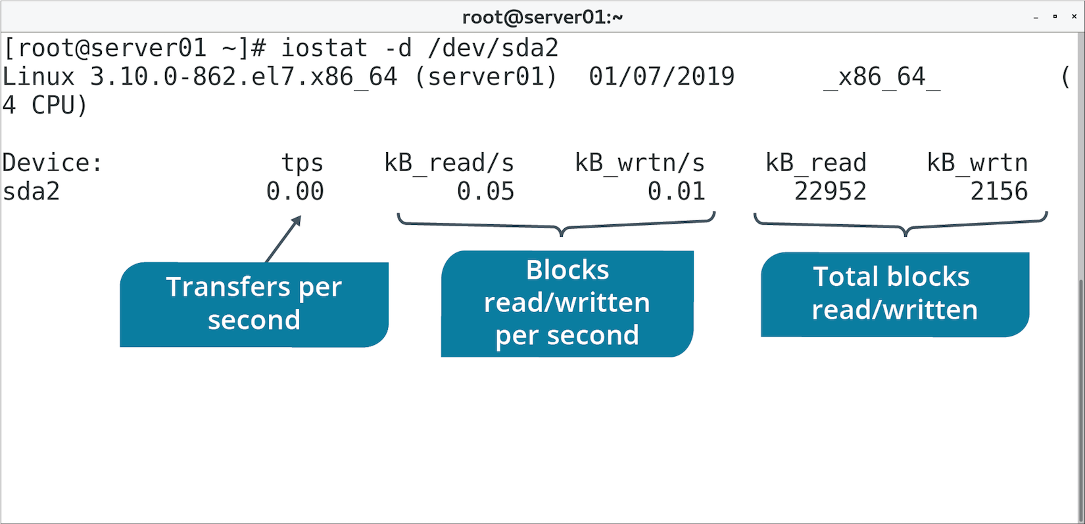
The iostat Command (Slide 2 of 2)

Slide 90
The ioping Command (Slide 1 of 2)
Generates report of device I/O latency in real-time.
Continuously "pings" device with requests.
Prints info about requests at CLI.
Tracks how long it took for I/O request to finish.
You can also specify path name to test associated device.
Use ioping to troubleshoot latency issues with storage devices.
Especially if read/write speeds are too slow.

Slide 91
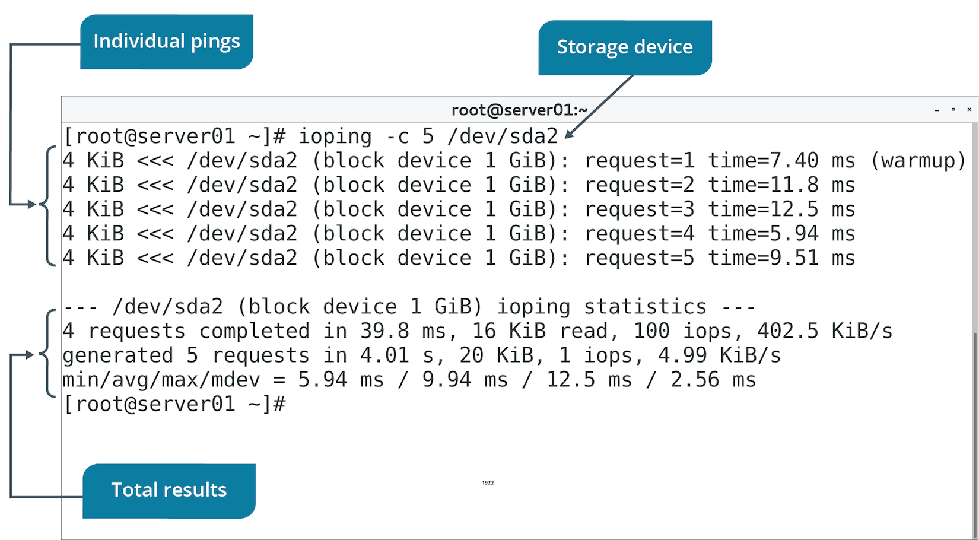
The ioping Command (Slide 2 of 2)

Slide 92
Storage Quotas
The storage space that is allotted to a user for file storage on a computer.
Configured per user.
Include soft limit, grace period, and hard limit.
User is placed in grace period if they exceed soft limit.
User can continue past this limit in the grace period, but can't exceed hard limit.
If user goes under soft limit, timer resets.
If user stays above soft limit when timer expires, soft limit becomes a hard limit.
Won't be able to use additional storage.
Good for preventing or responding to storage consumption issues.
Can ensure users aren't taking up too much space.

Slide 93
Quota Management Commands
Command | Used To
quotacheck -cug {mount point} | Create quota database files for file system and check user/group quotas.
edquota -u {user name} | Edit quotas for specific user.
edquota -g {group name} | Edit quotas for specific group.
setquota -u {user name} | Set quotas for specific user.
setquota -g {group name} | Set quotas for specific group.

Slide 94
Quota Reports (Slide 1 of 2)
You can view how storage is being used by each user.
Can help you troubleshoot quota issues.
Details:
Name of user/group.
Total blocks being used.
Soft limited on storage.
Hard limit on storage.
Grace period.
Total inodes being used.
Soft limit on inodes.
Hard limit on inodes.

Slide 95
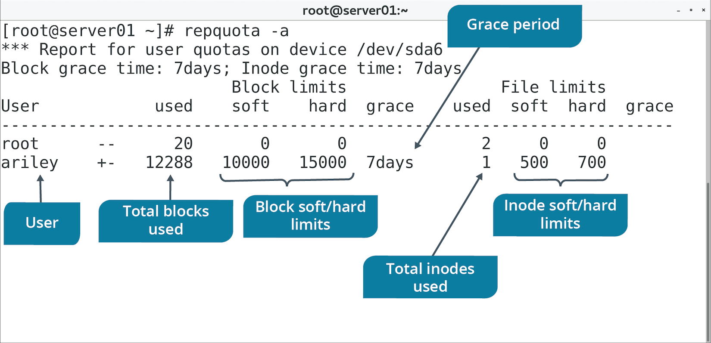
Quota Reports (Slide 2 of 2)

Slide 96
Additional Storage Troubleshooting Techniques
Start with the simple, work toward the complex.
Example: User can't create file.
They have adequate permissions.
Check if storage is available.
Check if there is free space.
Look for inode exhaustion.
If storage is unavailable:
Verify physical connections.
Check /dev/ and /proc/ to see if system recognizes storage.
Check configuration files for errors.
Use tools like fsck, XFS tools, ext4 tools, etc.

Slide 97
Guidelines for Troubleshooting Storage Issues
Ensure devices are physically connected to system.
Ensure devices are powered.
Ensure devices are turned on.
Verify device is recognized by the system.
Confirm that config files don't contain errors.
Ensure config files have been reloaded if you made changes.
Confirm there is enough storage capacity.
Confirm that I/O workload isn't overwhelming device.
Use partprobe to scan for new storage devices and partitions.

Slide 98
Discussing Storage Issues

Slide 99
Activity: Tracking Storage Space Usage
Users are complaining about poor performance for storage operations.
Some have run into errors about device being full.
Trying to back up their user data.
You'll diagnose the storage issues.

Slide 100
Activity: Configuring Storage Quotas
Most files on data backup volume were created by [user name]
You want to limit storage space usage for this user.
Limitations:
Block (soft)=10000
Block (hard)=15000
Inode (soft)=500
Inode (hard)=700
Will help prevent issues related to storage.

Slide 101
Do you or would you prefer to work with standard partitions or logical volumes? Why?
What file system types have you worked with? What advantages and disadvantages have you encountered with each?

